Slide 1

Band-Stop Filter Design and Implementation
This presentation outlines the design and implementation of a band-stop filter for removing unwanted frequencies from a signal. The filter was designed and implemented using MATLAB and LabVIEW, respectively, and tested on the Speedy 33 Kit.
by Muhammad Yaseen

Slide 2

Filter Specifications and Objectives
Stopband Attenuation
Passband Ripple
Transition Width
The filter must reject frequencies between 2 kHz and 3 kHz with an attenuation of at least 40 dB.
The filter must have a passband ripple of 0.01 dB or less to ensure minimal distortion of the desired signal.
The transition width, the region between the passband and stopband, must be 50 Hz or less for a sharp cutoff.

Slide 3
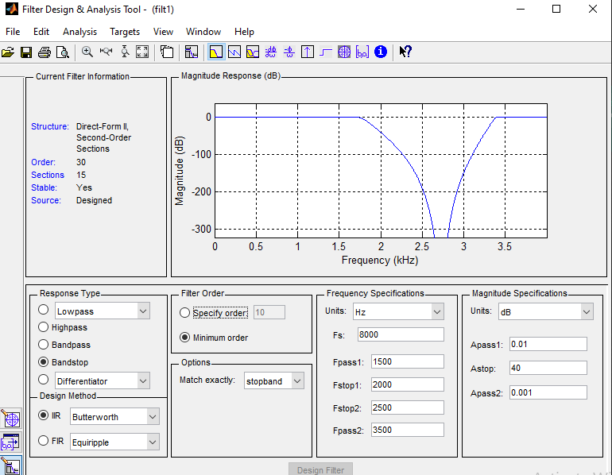

Slide 4
Filter Design Methodology: MATLAB
Signal Processing Tool
Filter Design Parameters
Filter Coefficients
MATLAB's Signal Processing Tool (SP Tool) was used to design the filter using the Kaiser window method for FIR filters and the Elliptic filter method for IIR filters.
The SP Tool allowed for defining the filter specifications, including the sampling frequency (8 kHz), cutoff frequencies (2 kHz and 3 kHz), and design parameters. The chosen filter type, FIR, dictated the design method.
The filter coefficients were exported from the SP Tool into the MATLAB workspace for use in the LabVIEW implementation.

Slide 5
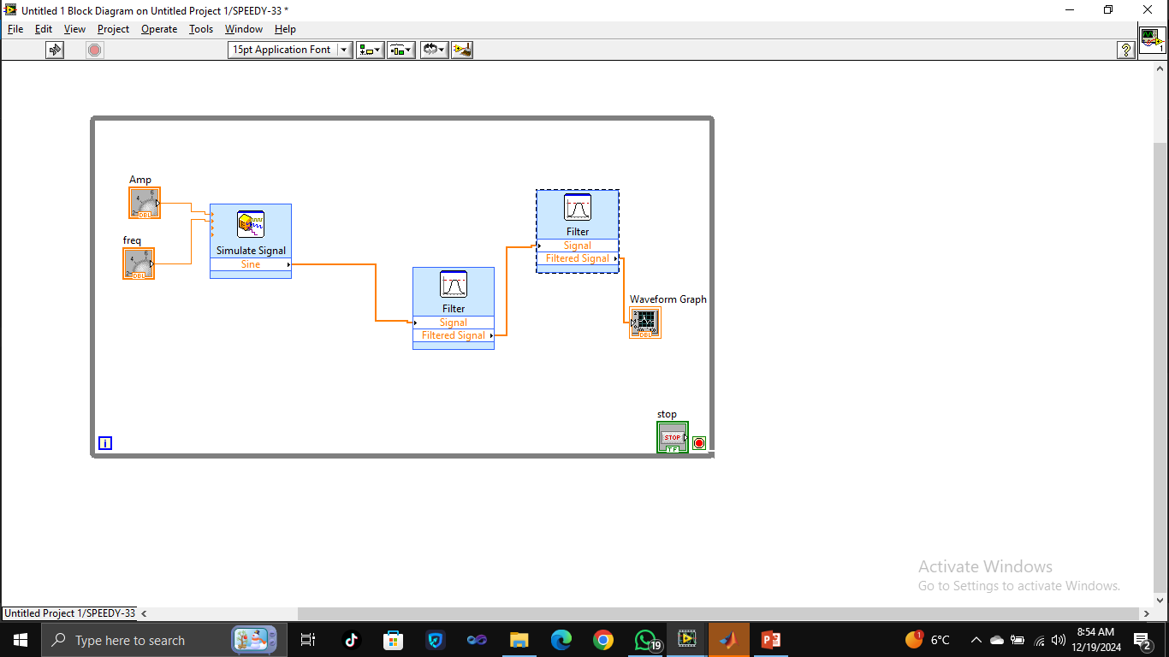
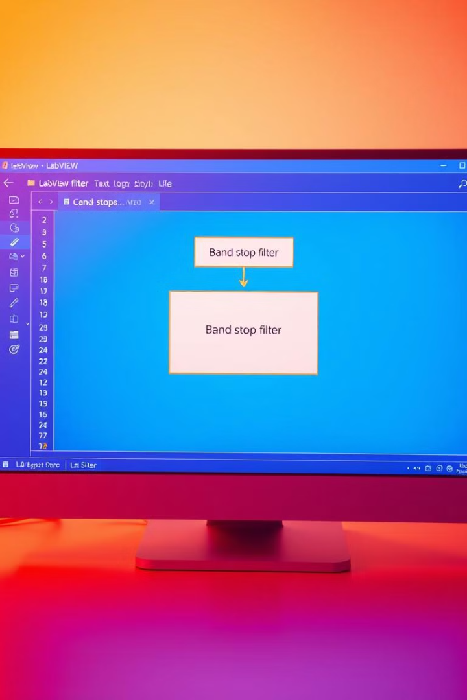
Filter Implementation: LabVIEW
LabVIEW Environment
Filter Design and Implementation
1
2
LabVIEW was used to create a VI (Virtual Instrument) for the filter implementation. The Speedy 33 Kit was connected and configured for a sampling frequency of 8 kHz.
The filter was implemented in LabVIEW using the Filter Express VI or custom block diagram using the imported filter coefficients.
3
Real-Time Signal Processing
The Speedy 33 Kit provided real-time signal input for testing the filter's performance.

Slide 6
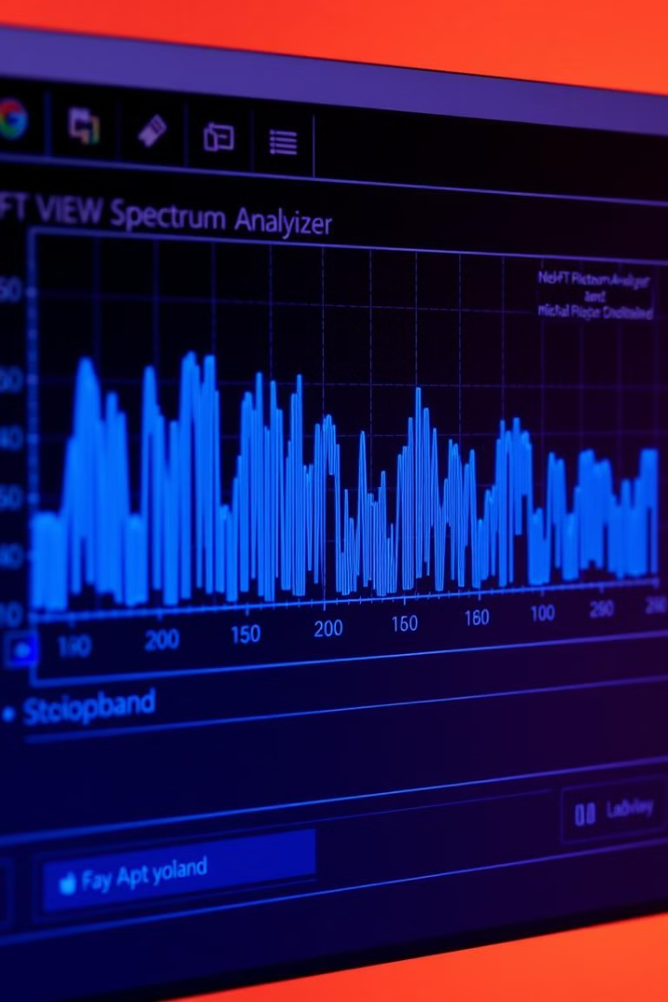



Performance Evaluation
Frequency Response Analysis
The filter's frequency response was analyzed using the FFT Spectrum Analyzer in LabVIEW.
Stopband Attenuation
The stopband attenuation was measured to ensure it met the specification of 40 dB.
Passband Ripple
The passband ripple was evaluated to confirm it remained below the 0.01 dB requirement.

Slide 7
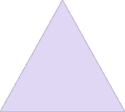




Applications of Band-Stop Filters
Noise Reduction
1
Removing unwanted noise or interference in specific frequency ranges.
Signal Enhancement
2
Improving signal quality by removing interfering frequencies.
Data Analysis
3
Focusing on desired signal components for analysis.
Medical Applications
4
Eliminating interference in medical equipment readings.
Communication Systems
5
Blocking unwanted signals in specific frequency bands.

Slide 8
Future Directions
Filter Order Optimization
1
Reducing the filter order for improved real-time performance.
Hardware Implementation
2
Exploring FPGA or DSP processors for more efficient real-time filtering.
Adaptive Filters
3
Designing adaptive band-stop filters to handle time-varying interference.

Slide 9
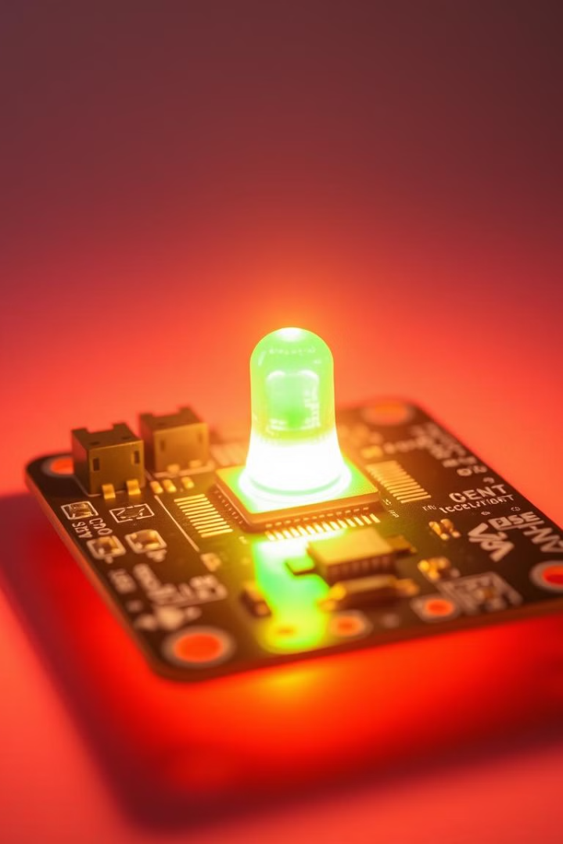
Conclusion
1
Successful Design
The designed and implemented band-stop filter effectively met all specifications, including 40 dB stopband attenuation and 0.01 dB passband ripple.
2
Real-Time Implementation
The filter was successfully implemented and tested in LabVIEW with the Speedy 33 Kit for real-time signal processing.
3
Future Research
Further research will focus on optimization, hardware implementation, and adaptive filter design.

Slide 10
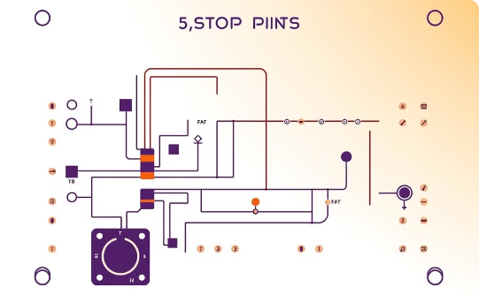
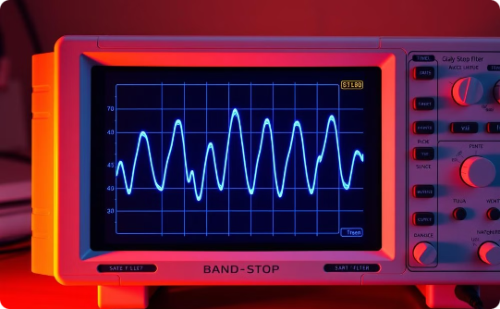

Key Takeaways
Understanding Design Principles
Effective Implementation
Practical Applications
Implementing filters using software tools like MATLAB and LabVIEW enables efficient testing and verification.
Band-stop filters have diverse applications in various fields, demonstrating their practical importance.
Gaining a strong foundation in filter design principles is essential for effective signal processing.

Slide 11

Next Steps
The next steps involve further research and development of the band-stop filter, including optimizing filter parameters, exploring hardware implementations, and investigating adaptive filter designs for more complex applications.

